Slide 1



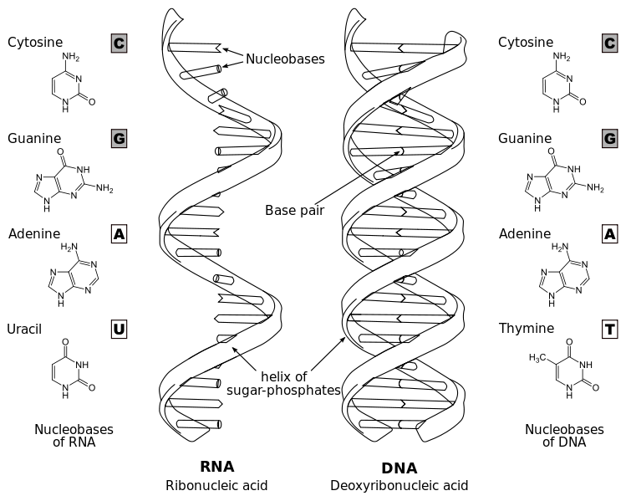
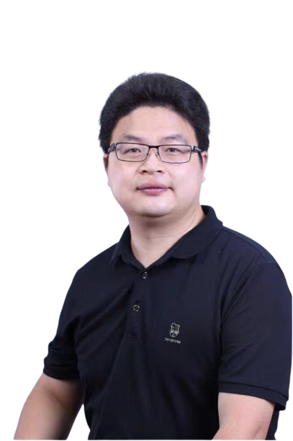
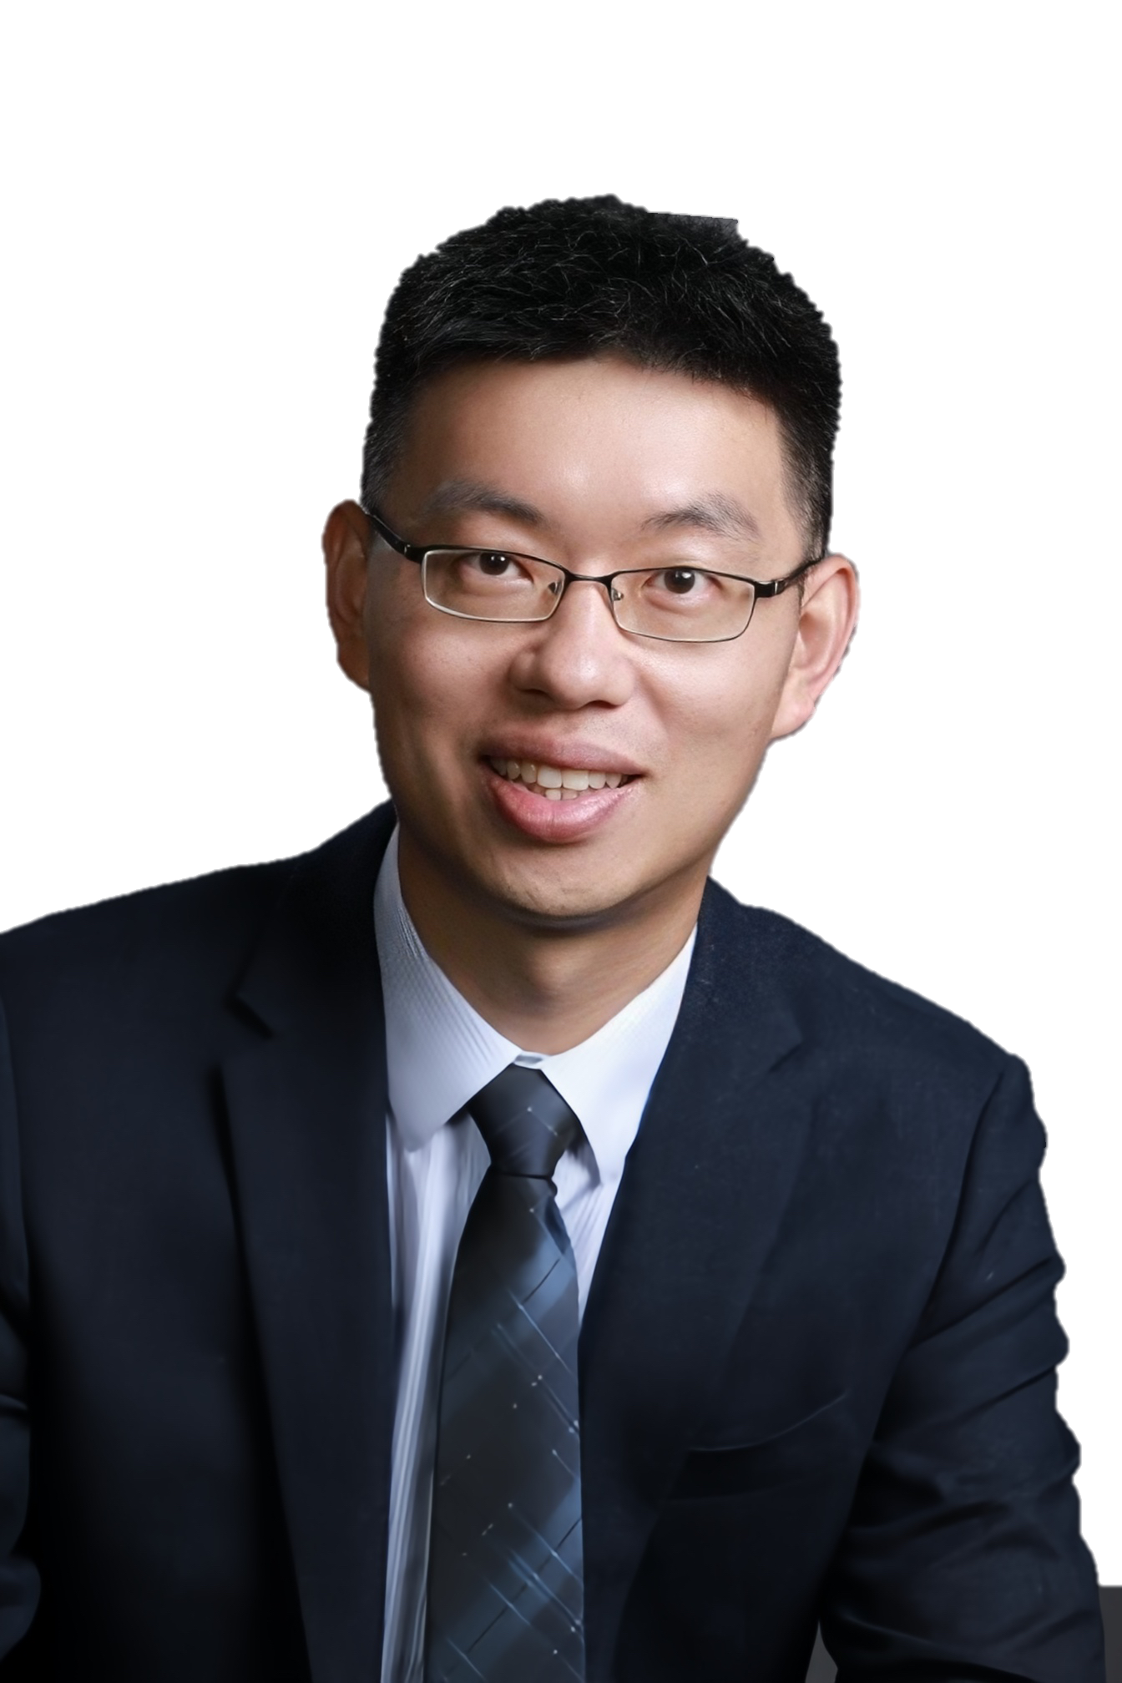
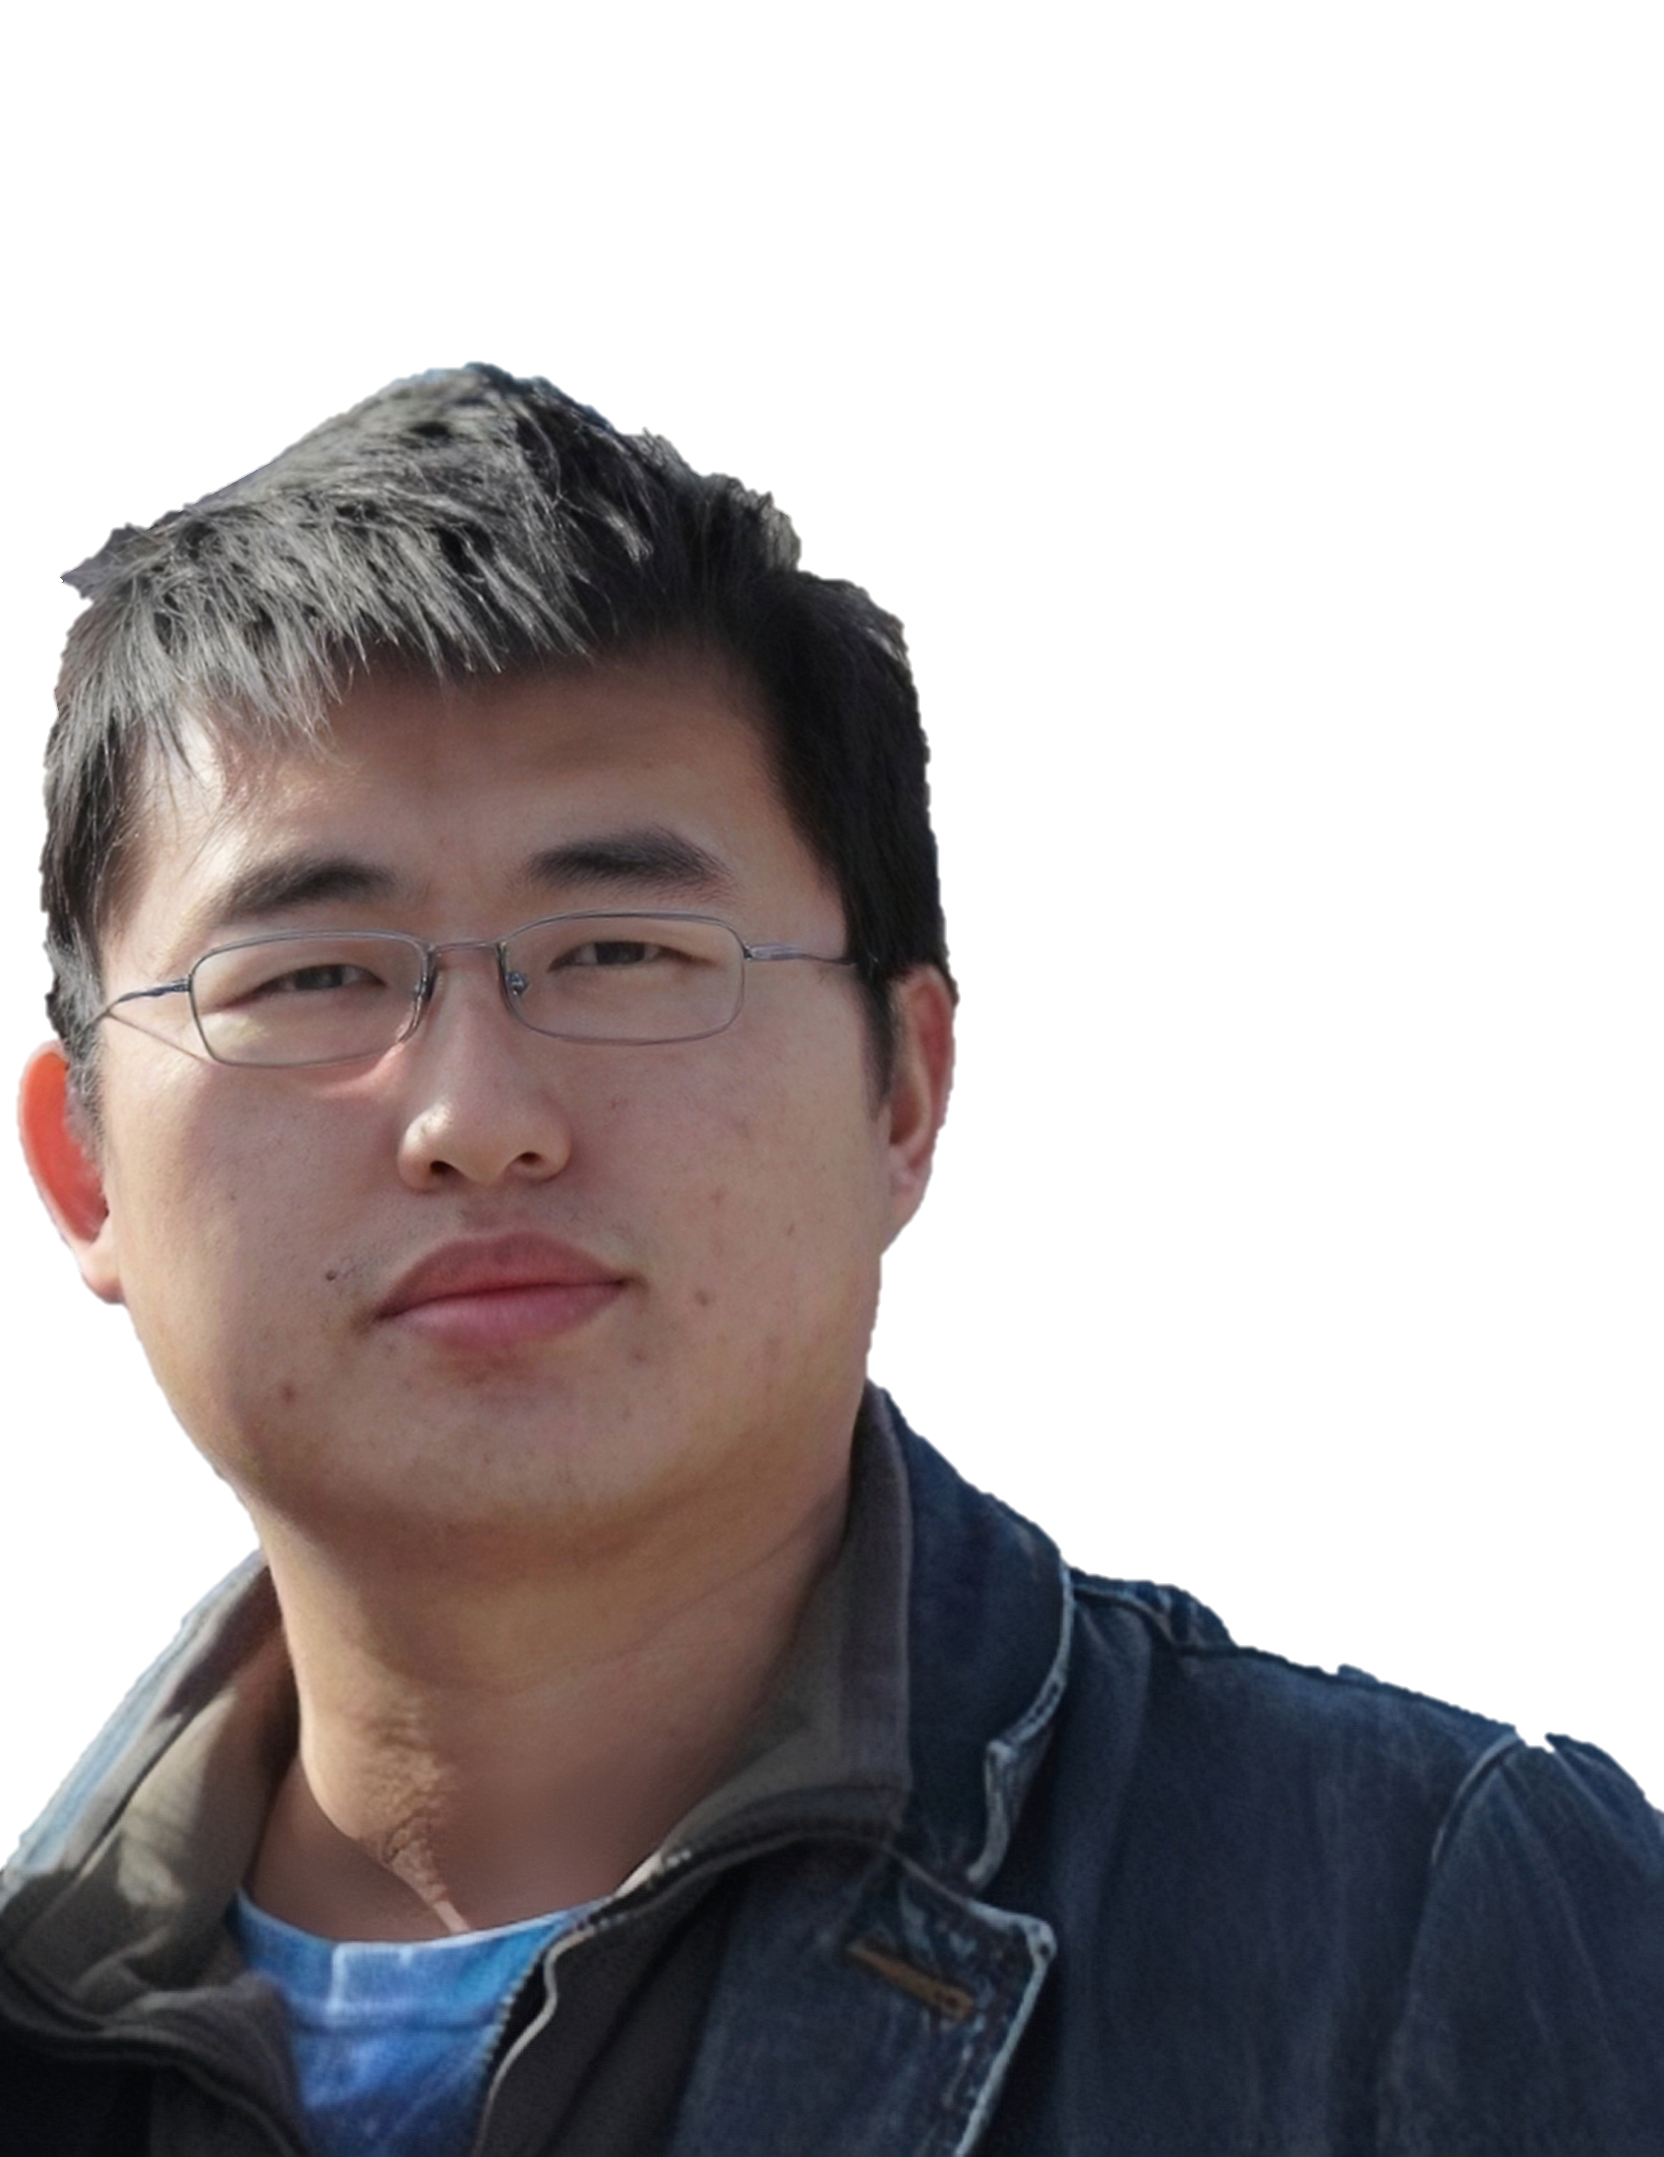
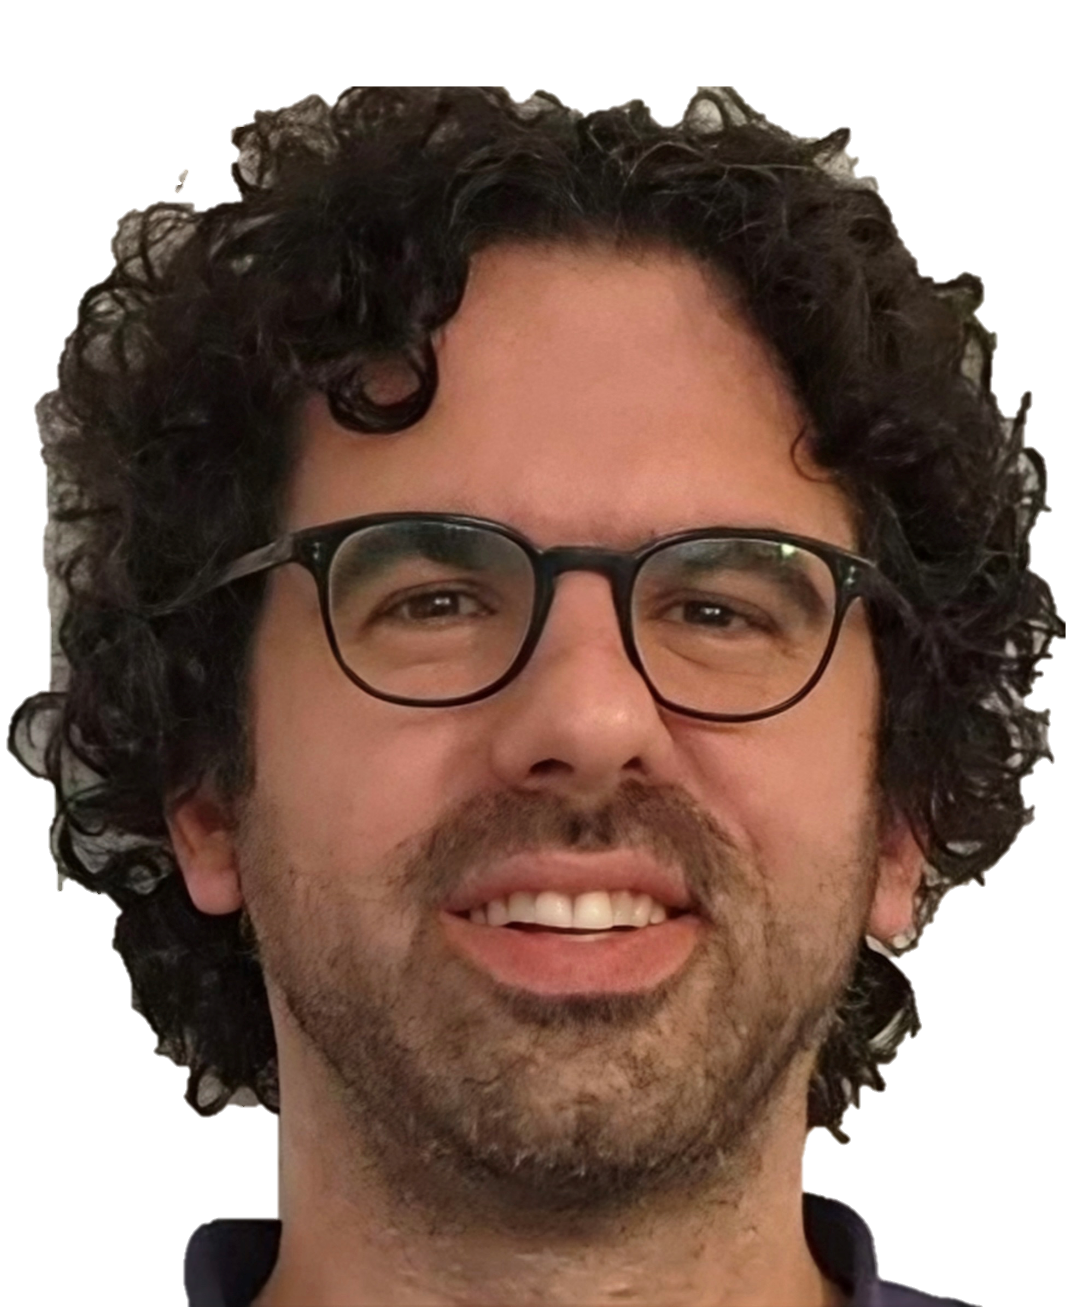
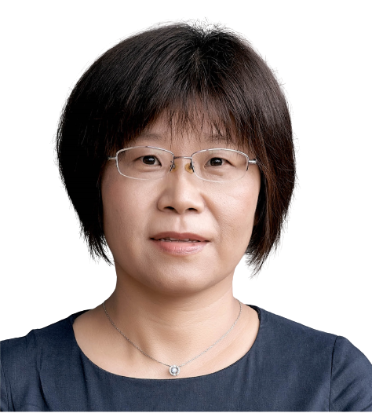
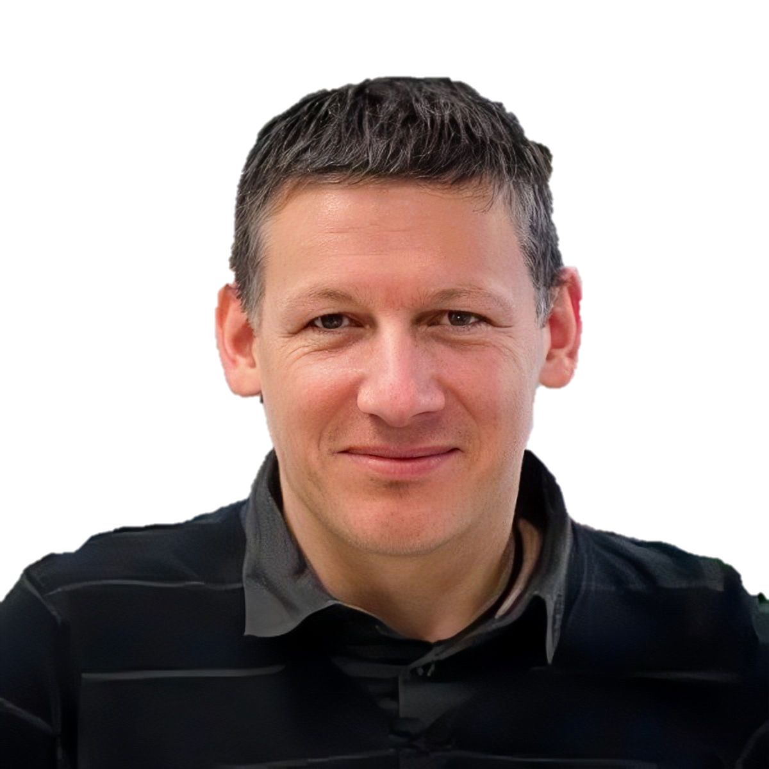
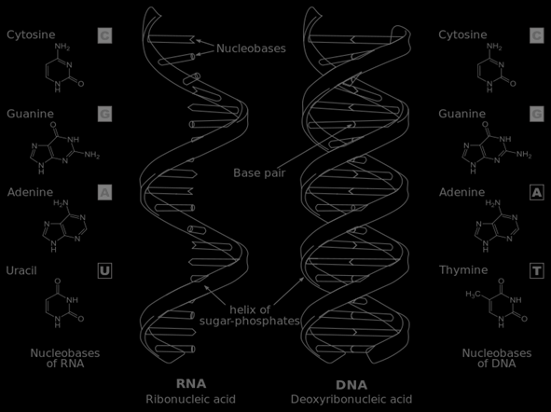
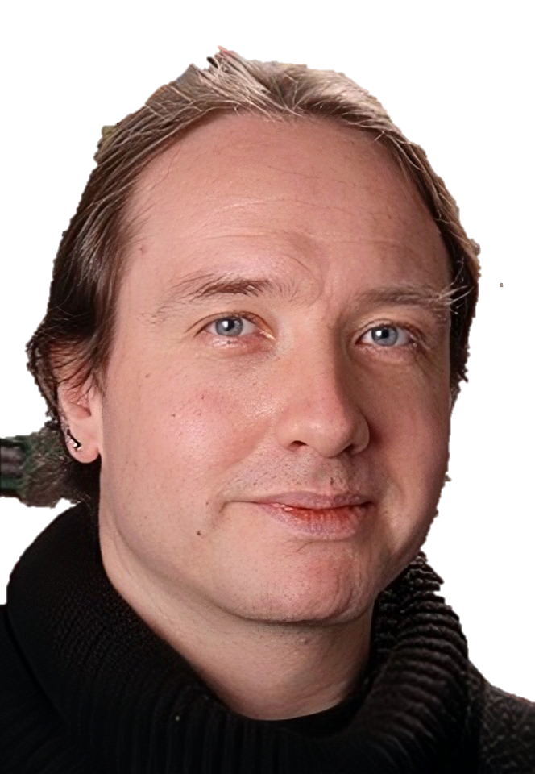
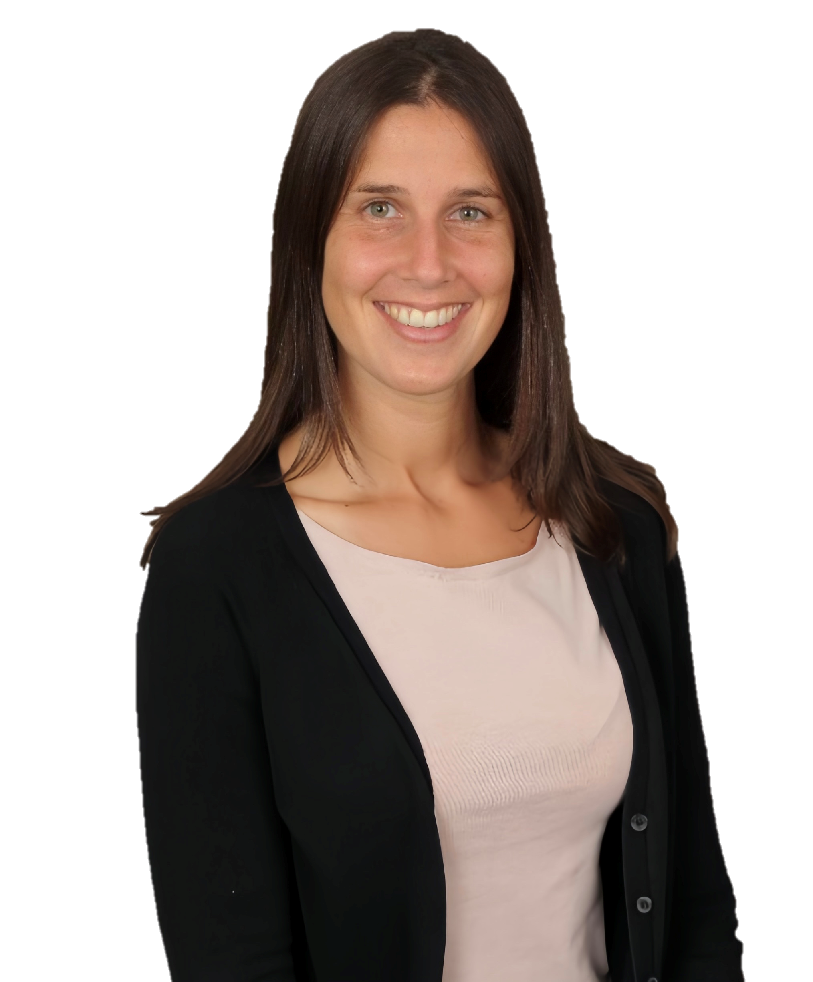

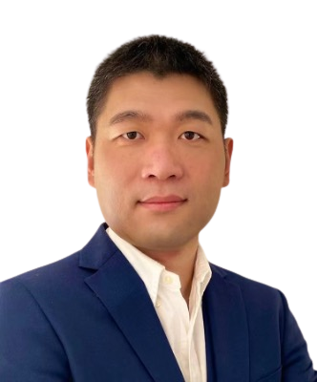
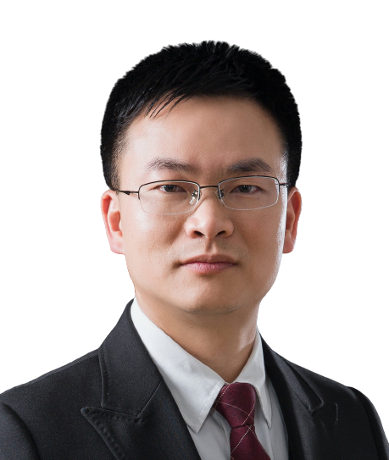
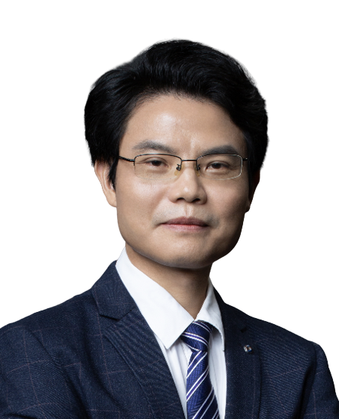
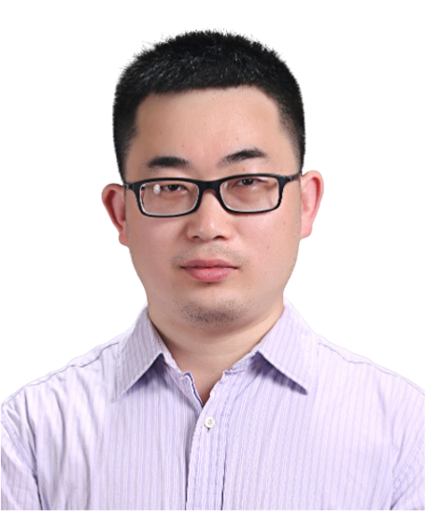





Guangzhou RNA club
2023 yearly symposium program
Time：Fri 14th July 2023
Zoom: https://us06web.zoom.us/j/82283798518?pwd=dk1NZlkvY2tLNWdueHl2Vmd0NjV2Zz09
(passcode: 666666)
Bilibili：https://live.bilibili.com/26427894
Speakers
Xing Li
Beijing Institutes of Life Science, CAS
Title: Fluorogenic RNA-based imaging and sensing applications
Time：9:00 AM
Hanyang Yu
Nanjing University
Title: Chemical biology of xeno-nucleic acids (XNAs)
Time：10:00 AM
Yang Yu
Guangzhou Women and Children's Medical Center, Guangzhou Medical University
Title: Eukaryotic CRISPR: a piRNA-guided “innate immune” system in genome defence
Time：11:00 AM
Zasha Weinberg
University of Leipzig
Title: Natural catalytic RNAs: strange structural variants in mysterious organisms
Time：14:00 PM GMT+8/ 8 AM CEST
Jingyi Hui
CAS Center for Excellence in Molecular Cell Science
Title: Targeting the oncogenic YB-1 protein in glioblastoma using RNA decoy oligonucleotides
Time：15:00 PM GMT+8
Franck Martin
University of Strasbourg
Title: Viral and cellular translation during SARS-CoV-2 infection
Time：16:00 PM GMT+8/ 10 AM CEST
James B. Procter
University of Dundee
Title: Interactive RNA alignment and analysis with Jalview
Time：17:00 PM GMT+8/ 10 AM BST
Kate Meyer
Duke University
Title: Understanding m6A-mediated RNA regulation in single cells
Time：23:00 PM GMT+8/ 11 AM EDT
HOSTS
Zhichao Miao
Guangzhou Laboratory
Guangzhou Medical University
Lin Huang
Sun Yat-sen University
Jianhua Yang
Sun Yat-sen University
Jinkai Wang
Sun Yat-sen University
Sponsors
德先生物

